Slide 1

Kairos Must Burn
The Most Courageous ISO Burning Tool Ever Made "Some tools change your workflow. This one changes history."

Slide 2
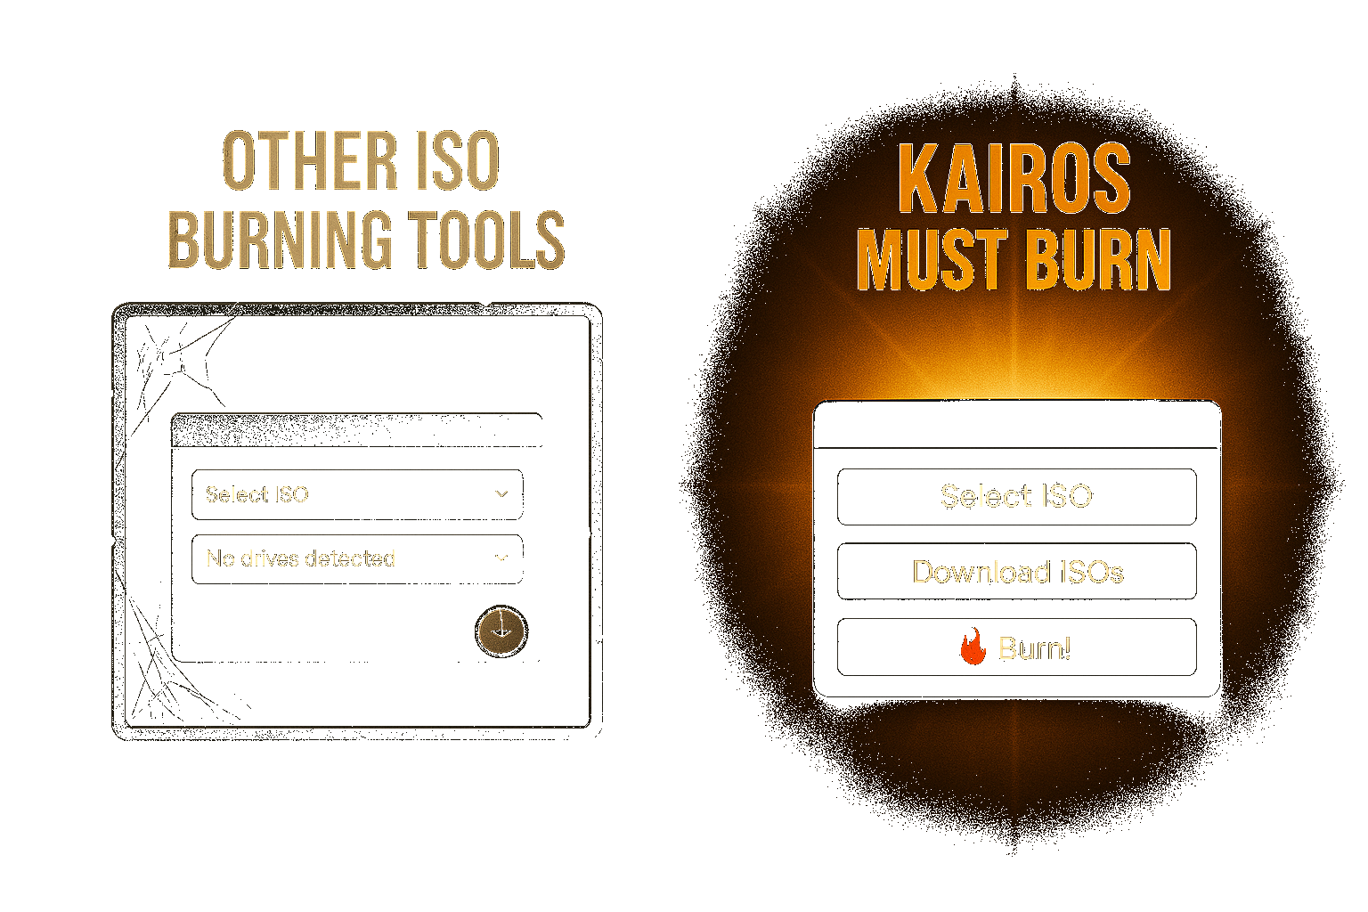
Burning ISOs. Reinvented.
Burning ISOs used to be... fine. Until now. - Meet Kairos Must Burn: the first ISO tool worthy of your USB stick. - It doesn't just burn. It incinerates expectations.

Slide 3
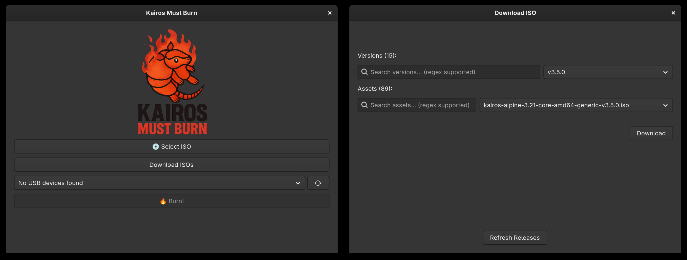
Click. Drag. Burn. Ascend.
"We reduced an entire OS pipeline to a single click. Because you deserve it." - Download ISOs directly from GitHub Releases - Choose your version, pick the asset, insert USB. Done. - No terminal. No YAML. Just pure courage.

Slide 4

Regex. On. Everything.
"What if search could feel... mythical?" - Blazing fast regex filtering. - Find your ISO by distro, arch, or obscure naming rituals. - It understands you like no other GUI has.

Slide 5
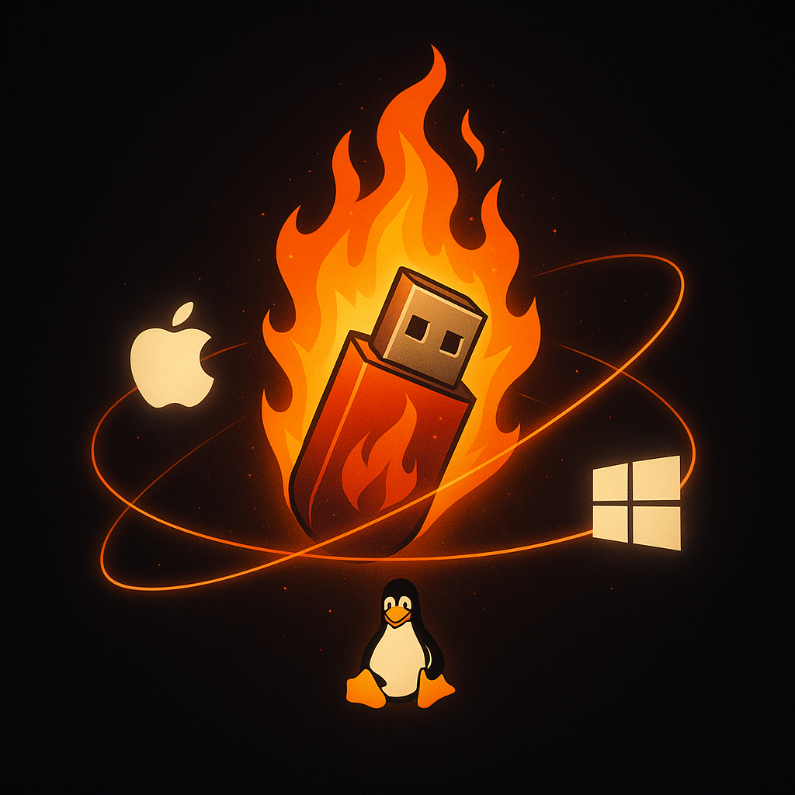
One App. Three Worlds.
"Designed for macOS. Refined for Linux. Somehow, it also works on Windows." - Cross-platform GUI built with love - No Electron. Just sleek GTK4 - Pixel-perfect experience on all major OSes

Slide 6
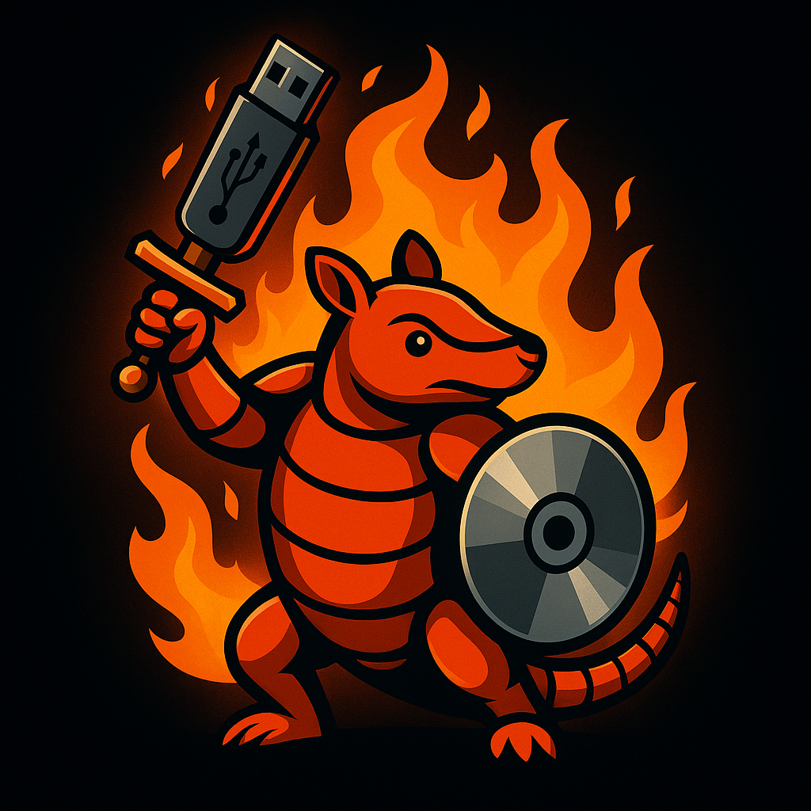
Download. Burn. Boot. Believe.
"You don’t just install an OS. You begin a new age." - Kairos Must Burn is available now - Open source. Gloriously over-engineered KAIROS MUST BURN "Because the moment deserves it."

